Slide 1
DCE meeting (02/06/2021)
Clément Canonne (Computer Science)

Slide 2
"Testing properties of data"
Data = measurements, observations, output of a model (digital twin). Assume discrete for now.
Property = pick your favourite model or assumption (unimodality/bimodality, shape assumption, parameterized family)
Testing = (composite) hypothesis testing, minimax sense

Slide 3
"Testing properties of data"
Data = measurements, observations, output of a model (digital twin). Assume discrete for now.
Property = pick your favourite model or assumption (unimodality/bimodality, shape assumption, parameterized family)
Testing = (composite) hypothesis testing, minimax sense, finite-sample
Applications: model selection, density estimation, anything where hypothesis testing can be used

Slide 4
"Testing properties of data"
Focus on finite-sample guarantees, non-asymptotic.
Computationally efficient estimators (poly-time, or even near-linear time in sample size)
Limitation: typically hard to give the explicit distribution of the test.
(Also, not quite sure how that fits in the Bayesian framework.)
Prototypical/most simple example: "given i.i.d. discrete observations from an unknown source, is the data uniformly distributed?"

Slide 5
A better example: bimodality
Is the data distribution bimodal?

Slide 6
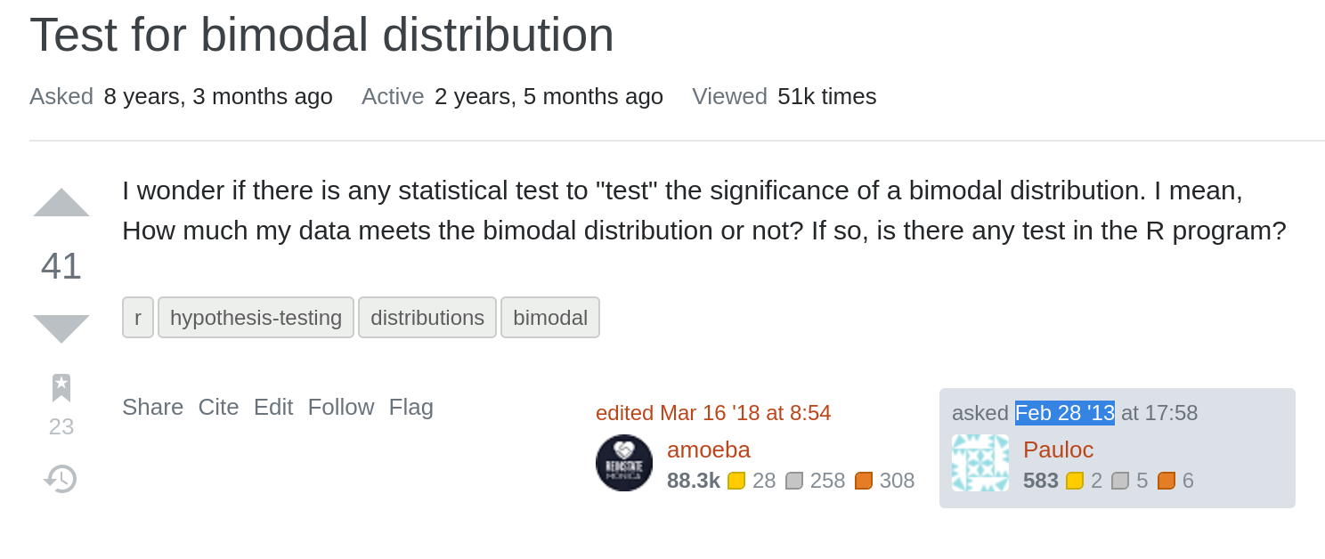
A better example: bimodality
Is the data distribution bimodal?
Many tests and approaches, many under strong assumptions (mixture models), some very naïve (compute some moment of skewness and kurtosis), some using fitting/density estimation.

Slide 7
A better example: bimodality
Give a general algorithm (with finite-sample guarantees) for testing
H₀: distribution is bimodal
v.
H₁: distribution at large statistical distance from every bimodal distribution
Canonne, C.L., Diakonikolas, I., Gouleakis, T. et al. Testing Shape Restrictions of Discrete Distributions. Theory Comput Syst 62, 4–62 (2018). https://doi.org/10.1007/s00224-017-9785-6

Slide 8
Why does it matter
Pros: Fast, near-sample optimal, generalisable: applies to many other properties ("shape constraints").
E.g., monotone, unimodal, t-modal, log-concave, concave, convex, monotone hazard rate, t-piecewise degree-d distributions...
Also performs density estimation as a side bonus, when H₀ is not rejected.
Cons: well, not actually implemented (just pseudocode)

Slide 9
Other similar tools
Other general testing algorithm for Fourier-constrained models: can very efficiently test any property comprised of things with a sparse discrete Fourier transform.
E.g., Poisson Binomial, sum of independent r.v's, log-concave
Clément L. Canonne, Ilias Diakonikolas, and Alistair Stewart. 2018. Testing for families of distributions via the Fourier transform. In Proceedings of the 32nd International Conference on Neural Information Processing Systems (NIPS'18).

Slide 10
Why does it matter?
Fast/efficient tools for model selection or hypothesis selection, which can be easily generalised: building blocks in a more complex system.

Slide 11
Why does it matter?
Fast/efficient tools for model selection or hypothesis selection, which can be easily generalised: building blocks in a more complex system.
Discrete data can be an issue...

Slide 12
Beyond discrete?
Given continuous data or underlying quantities, how to measure/quantise them?
💡 With some specific goal in mind: say, density estimation or hypothesis testing (goodness-of-fit).

Slide 13
Quantization
Optimal quantization for density estimation or goodness-of-fit testing for a fixed quantization budget:
starting with discrete data (but too large domain)
parameterized families (e.g., high-dim Gaussians*)
continuous data (Sobolev or Besov classes)
adaptive/nonadaptive settings
Again, general "tools" and results.
Joint works with Jayadev Acharya and Himanshu Tyagi + Yuhan Liu, Aditya Singh, Ziteng Sun, and Prathamesh Mayekar.

Slide 14
Summary
Those "building blocks" can hopefully be helpful as components of larger systems ⚙️. Techniques and ideas general by design, so ought to be extendable to other tasks of interest.
(Sorry for the lack of nice pictures...)

